Slide 1
8051 Memory Organization & Memory Interfacing

Slide 2
Introduction to 8051 Memory
The 8051 microcontroller has a well-defined memory architecture.
Memory is divided into Program Memory (ROM) and Data Memory (RAM).
Supports internal and external memory expansion.

Slide 3
Memory Organization in 8051
Program Memory (ROM)
Internal ROM: 4KB (in standard 8051)
External ROM: Up to 64KB (if needed)
Accessed using PSEN (Program Store Enable)
Data Memory (RAM)
Internal RAM: 128 bytes
External RAM: Up to 64KB (accessed using MOVX instruction)
Divided into:
Register Banks (0-31 bytes)
Bit-Addressable RAM (32 bytes, 20H-2FH)
General-Purpose RAM (30H-7FH)

Slide 4
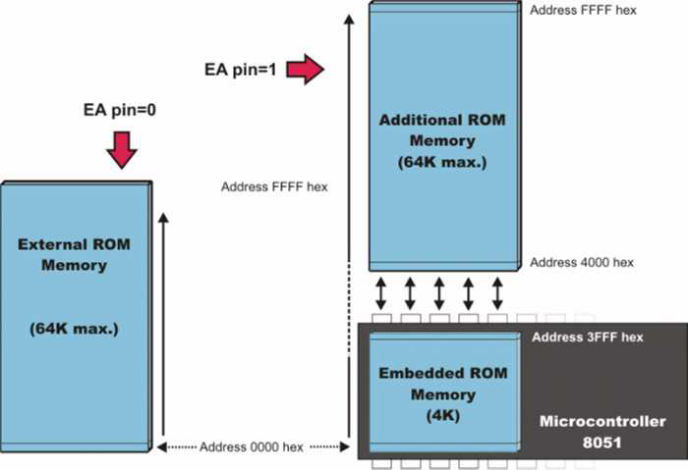
Program Memory (ROM) Organization

Slide 5
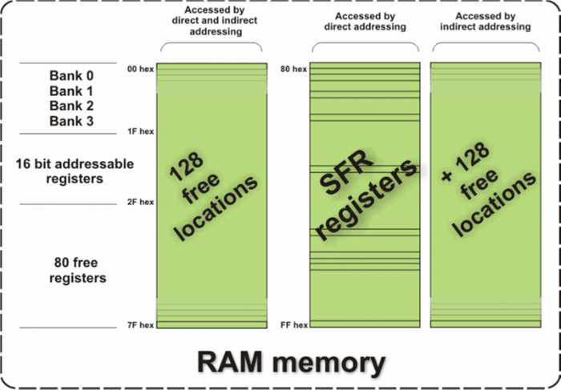
Data Memory (RAM)

Slide 6
Special Function Registers (SFRs)
Located in upper 128 bytes (80H-FFH).
Used to control Timers, Serial Communication, Ports, Interrupts, etc.
Examples:
P0-P3 (I/O Ports)
TCON (Timer Control)
SCON (Serial Control)
IE (Interrupt Enable)

Slide 7
Memory Interfacing in 8051
External memory is interfaced using Address, Data, and Control signals.
Two types:
External Program Memory (ROM): Accessed using PSEN.
External Data Memory (RAM): Accessed using RD & WR.

Slide 8
Interfacing External ROM
Used when program size > 4KB.
Address Bus (A0-A15) → ROM
Data Bus (D0-D7) → ROM
PSEN → ROM Output Enable (OE)
ALE → Latch Lower Address
EA (External Access): Set to 0 for full external ROM access.

Slide 9
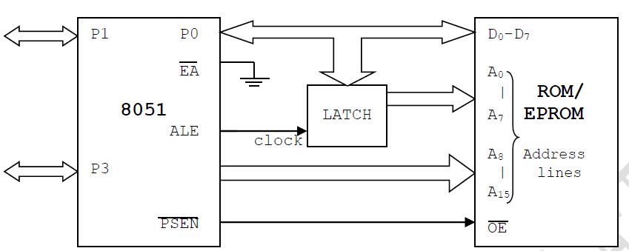
EXTERNAL ROM (PROGRAM MEMORY) INTERFACING

Slide 10
Interfacing External RAM
Used when internal RAM (128 bytes) is insufficient.
Address Bus (A0-A15) → RAM
Data Bus (D0-D7) → RAM
RD & WR Signals → RAM Read/Write Control
ALE → Latch Lower Address
74LS138 Decoder used for Chip Selection.

Slide 11
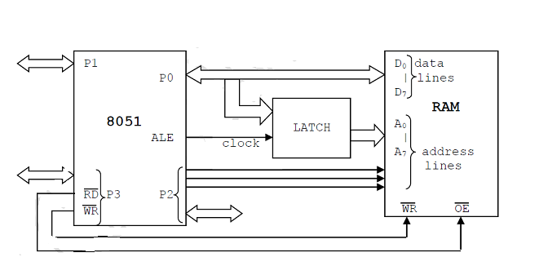
EXTERNAL RAM (DATA MEMORY) INTERFACING

Slide 12
Schematic for External Memory Interfacing
Shows connection of 8051 with 8KB ROM & 8KB RAM.
74LS373 (Latch) used for Address Bus Latching.
74LS138 (Decoder) used for Memory Selection.

Slide 13
Steps For Interfacing-external RAM/ROM interface.
To interface both program ROM and data RAM to 8051,
Let’s say we want to interface 16KB data RAM, 16KB program ROM, then we’ll have to follow the following steps:
Step 1: Calculate the number of address lines required to access 16KB of data, that is 2^14 = 16KB. Here, we require 14 address lines A0 – A13.
Step 2: Decide the location of RAM and ROM, here we are going to interface program ROM from 0000H and data RAM from 8000H.
Step 3: Select the decoder circuit, here we’re going to select 74LS138 decoder.
Step 4: We do not need a decoder circuit for program ROM, but we have to connect the 74LS138 decoder to data ROM and data RAM.
Step 5: Connect G1 to VCC, G2A, and G2B to ground.
Step 6: Connect input A and B to P2.6 and P2.7 respectively, and the input C to ground.
Step 7: We connect external program and data ROM, for that we can use an AND gate with its input being signal from RD (to access external data space) and PSEN (to access external program space) and output to OE of external ROM.
Step 8: To interface the external RAM, we connect both RD and WR to WE and OE respectively of external RAM.

Slide 14
Code Example (Assembly)
ORG 0000H
MOV DPTR, #2000H ; Load external RAM address
MOV A, #55H ; Data to write
MOVX @DPTR, A ; Write to external RAM
MOV DPTR, #2000H ; Load same address
MOVX A, @DPTR ; Read from external RAM
SJMP $ ; Infinite loop
END

